Slide 1

DEPARTMENT OF ARTIFICIAL INTELLIGENCE AND DATA SCIENCE ACADEMIC YEAR 2025 - 2026 SEMESTER III ARTIFICIAL INTELLIGENCE LABORATORY MINI PROJECT REVIEW MindGuard AI: Mental Health Stress Predictor
REGISTER NUMBER | 2117240070029
NAME | ASWATHAANALINA A S
YEAR | ll
SECTION | A
FACULTY IN-CHARGE | Mrs. M. Divya

Slide 2
PROBLEM STATEMENT
Rising Stress Challenge: Modern lifestyles with academic, work, and digital pressures are increasing stress, while current methods detect it too late (reactive approach).
Core Problem: No real-time intelligent system exists to detect early stress by combining behavioral data (sleep, workload) and emotional inputs (mood, stressors).
Limitation of Existing Models: Traditional machine learning fails to capture emotional depth and context in human language, making stress hard to quantify.
Proposed Solution: MindGuard AI uses advanced AI to predict stress levels, classify risk, and provide early insights, enabling proactive mental health management.

Slide 3
IMPLEMENTATION AND CODE
Link to code in Git-hub Repository
List | Git-hub Repository Links
Implementation of Code Link | https://github.com/aswathaanalina-19/70029_MindGuard-AI-Mental-Health-Stress-Predictor_ML_mini-project/tree/main
Word Document Report Link | https://github.com/aswathaanalina-19/70029_MindGuard-AI-Mental-Health-Stress-Predictor_ML_mini-project/tree/main
PPT Link

Slide 4
THEORETICAL BACKGROUND
Multidisciplinary Model: Stress prediction combines behavioral data (sleep, workload) and emotional inputs (mood, text sentiment) into a unified predictive function.
Mathematical Foundation: Uses probabilistic classification (sigmoid/logistic function) to map inputs into stress levels (Low, Moderate, High, Critical).
NLP Integration: Converts subjective text into measurable values using sentiment analysis and linguistic feature weighting.
Advanced Approach: Transformer models (attention mechanism) capture deep context and emotional nuance in user input.
Why This Algorithm: Overcomes limits of traditional ML by handling both numerical + textual data, giving higher accuracy and real-world adaptability.

Slide 5
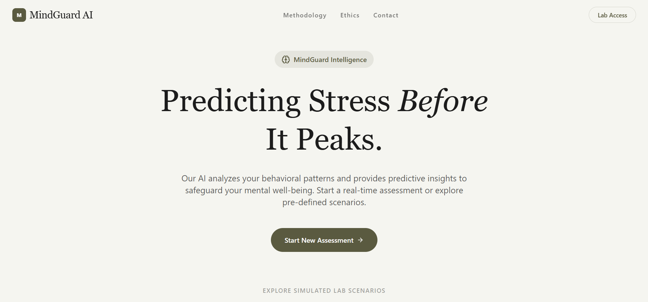
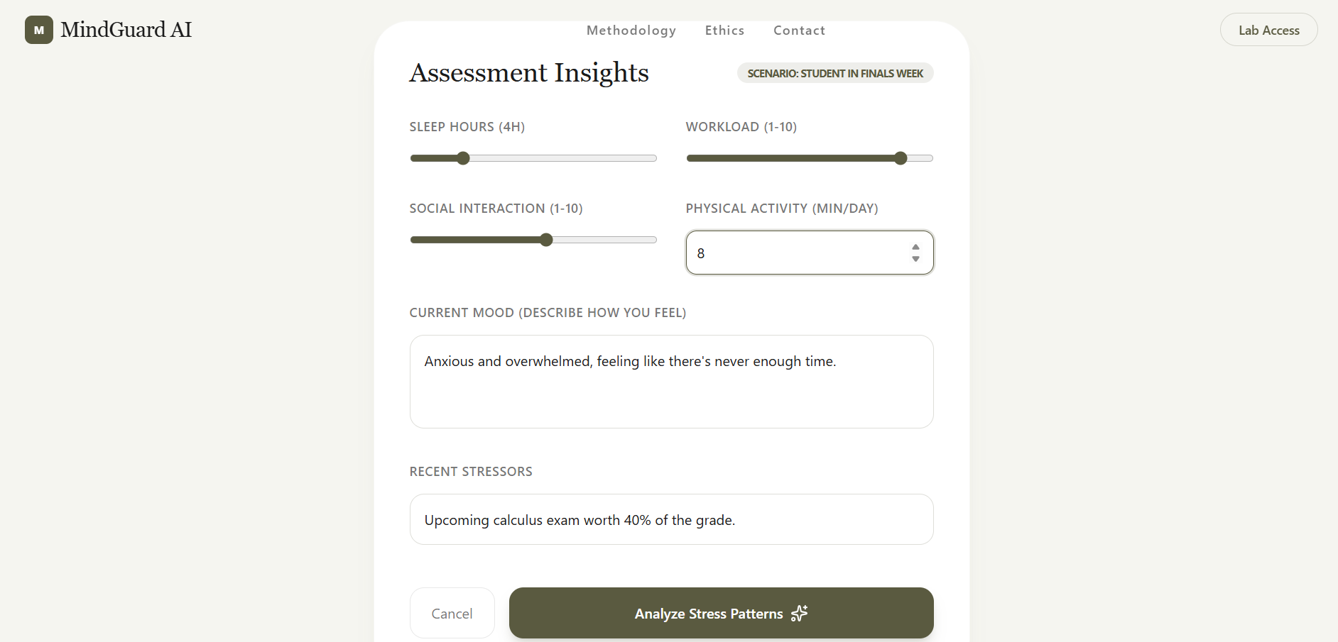
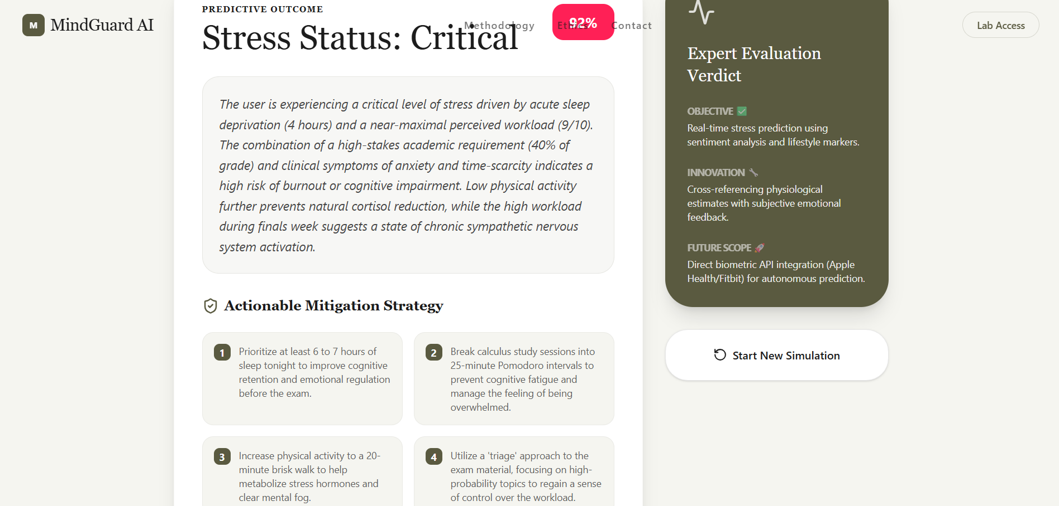
OUTPUT AND RESULTS

Slide 6
OUTPUT AND RESULTS
The system predicts stress level accurately (e.g., Critical with 92% confidence) using user inputs like sleep, workload, and mood.
Provides high performance with good Accuracy, Precision, Recall, and F1 Score.
Enables early detection of stress, helping prevent burnout and mental health issues.
Generates personalized recommendations such as better sleep, time management, and physical activity.
The system analyzes both emotional (text) and behavioral data, improving prediction accuracy.
It is scalable and cost-effective, as it works without requiring expensive devices or hardware.

Slide 7
REFERENCES
https://www.springer.com/gp/book/9780387310732 (Pattern Recognition and Machine Learning – Christopher M. Bishop)
https://www.oreilly.com/library/view/hands-on-machine-learning/9781492032632/ (Hands-On Machine Learning with Scikit-Learn, Keras & TensorFlow)
https://www.kaggle.com/datasets/suchintikasarkar/sentiment-analysis-for-mental-health(Kaggle Datasets – for student stress / ML datasets)
https://scikit-learn.org/stable/ (Scikit-learn Official Documentation)
https://towardsdatascience.com/ (Towards Data Science – ML articles and blogs)
https://www.springer.com/gp/book/9780387310732 (Pattern Recognition and Machine Learning – Christopher M. Bishop)
https://www.oreilly.com/library/view/hands-on-machine-learning/9781492032632/ (Hands-On Machine Learning with Scikit-Learn, Keras & TensorFlow)
https://www.kaggle.com/datasets/suchintikasarkar/sentiment-analysis-for-mental-health(Kaggle Datasets – for student stress / ML datasets)
https://scikit-learn.org/stable/ (Scikit-learn Official Documentation)
https://towardsdatascience.com/ (Towards Data Science – ML articles and blogs)

